Slide 1

AI Tutor Chatbot
Agentic Retrieval-Augmented Generation (RAG)

Slide 2
Agenda
Project Overview & Key Objectives
High-Level Architecture
Core Features & Tools
Performance & Evaluation
Conclusion & Future Directions

Slide 3









Project Overview & Key Objectives
AI Tutor Chatbot
addresses classical RAG limits using agentic capabilities
Local CPU/GPU & Offline-Focused
avoids reliance on persistent online infrastructure
Core Components:
LLMs (e.g., Llama) for language understanding & generation
Chroma + sentence-transformer embeddings for semantic retrieval
LangChain & LangGraph for prompt flow and tool management

Slide 4
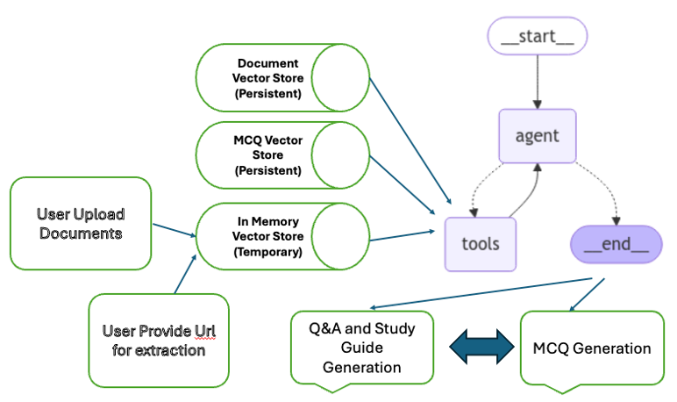
High-Level Architecture
Nodes
LLM Agent
Tool Invocations
Memory Summaries
Vector Stores (Chroma)
general_vs
mcq_vs
in_memory_vs
LLM Integration
vLLM
ChatGroq with OpenAI-compatible API
Gradio UI

Slide 5
Core Features & Tools
JSON-based calls (StructuredTool classes)
Utilizes structured JSON for tool interactions
Retrieval Methods
Similarity Search
Ensemble methods for improved accuracy
MCQ (Multiple Choice Questions) retrieval
Session Memory & Summaries
“Summary Tool” for finalizing context
Short-term memory (in-memory)
Long-term memory (persistent stores)

Slide 6
Development Phases
Planning & Conceptualisation
Research of the tools and packages
Complete development of Vector Database
Develop the Retrieval Tools
Explore different approach LangChain / LangGraph
Develop with Groq API
Develop with Huggingface Pretrained Models
Overcome challenges, use vLLM
Deploy with Docker to Hugging face Spaces and Azure Container Instances

Slide 7
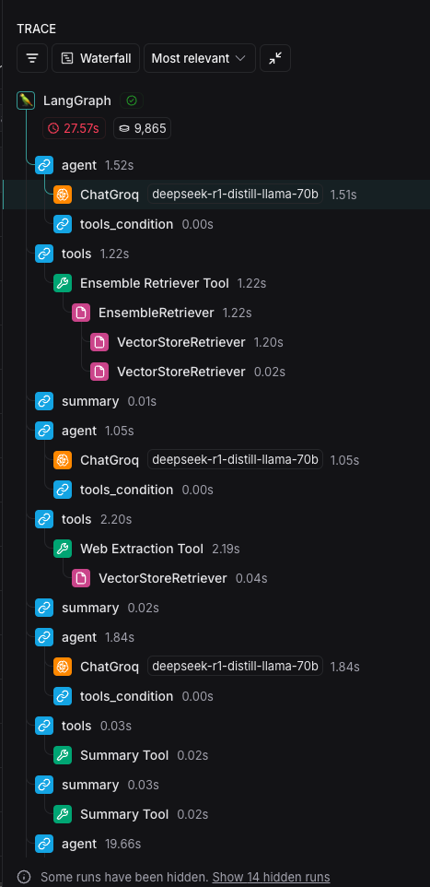
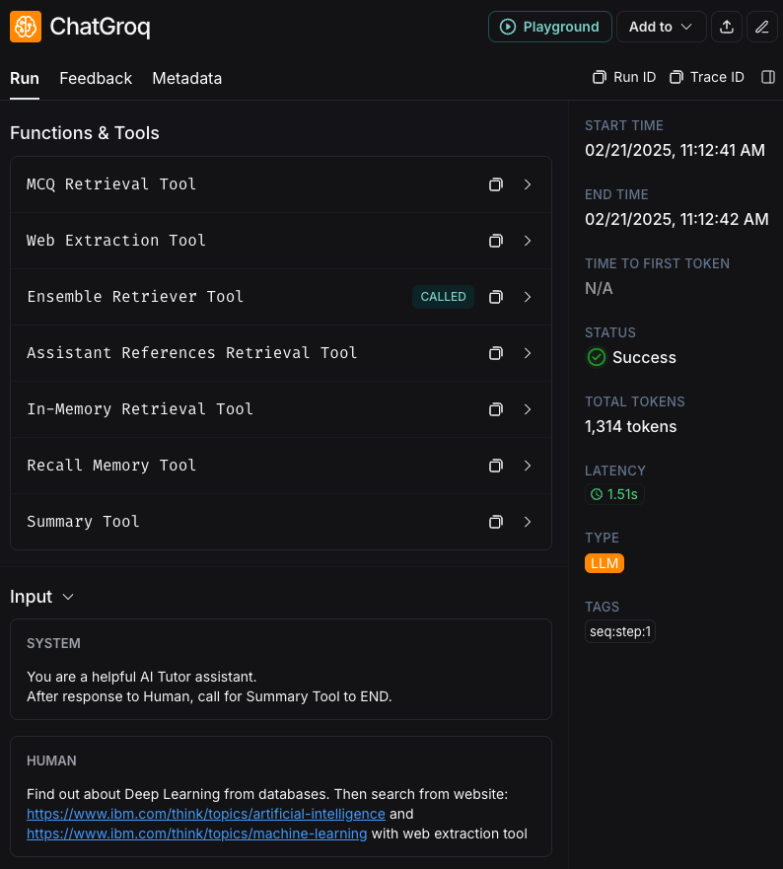
Performance & Evaluation
Testing Aspects
Relevance, completeness, and correctness of answers
LangSmith Observability Features
Logs each step and tool call
Helps refine prompts and measure hallucinations
Key Challenges
Smaller/quantized models struggle with correct JSON outputs
Docker and resource constraints for deployment

Slide 8
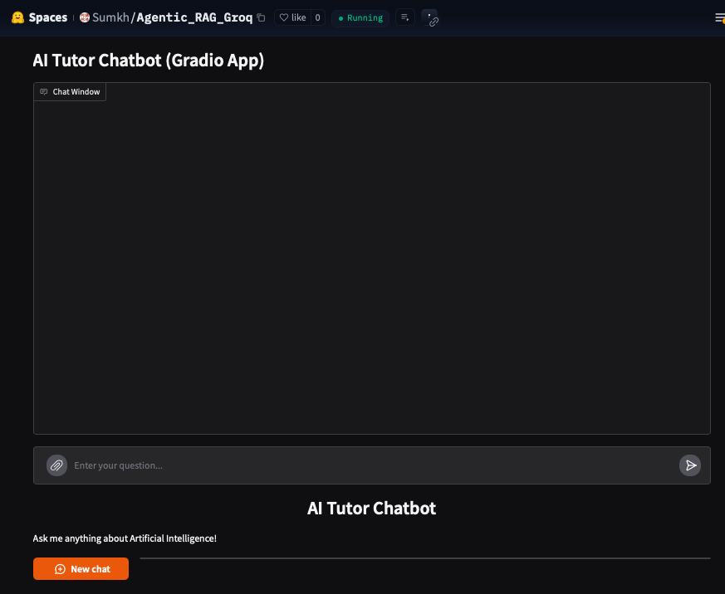
Conclusion & Future Directions
Achievements
Agentic RAG with dynamic memory and advanced tool usage
Education-focused features including MCQ retrieval and quiz checks
Future Enhancements
Domain-specific fine-tuning
Quantization to reduce resource requirement

